Slide 1
Introduction
In this project we are going to see how to successfully build an pipeline to host and scale an app using various CI/CD tools
We will leverage tools such as Git, Docker, Jenkins, Ansible, Kubernetes and spin an virtual machine to build our pipeline
We will go through three major stages to publish our app
1.Code
2.Build
3.Deploy

Slide 2
Tools Used
Git
Docker
Jenkins
Ansible
Kubernetes
Virtual machine

Slide 3
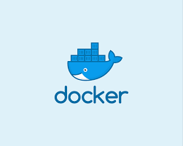
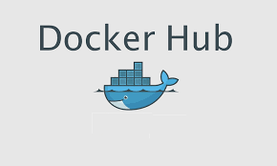
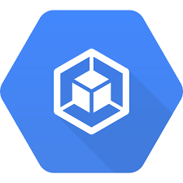
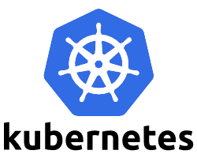
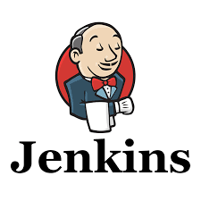
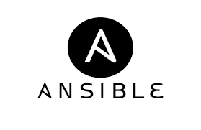

Overview of the pipeline
Service
Expose to local host

Slide 4
Explanation of the pipeline
https://hub.docker.com/u/sarankaja
Scaling
Image used in K8’s
It triggers docker to build an image
Host Jenkins
Service
Pulls code from git
The build will trigger Ansible
Expose to local host
https://github.com/kajasaran/2020_03_DO_Boston_casestudy_part_1

Slide 5
Explanation
The changes we make to the code are pushed to Git.
We then open docker and run Jenkins on one docker container.
We configure a Jenkins pipeline using our git repo.
The changes made in git trigger a build in Jenkins and it will start building the code that has been pulled from git and runs test cases.
Once the testcases are successful it pushes the code to the docker and creates an image which is pushed to our docker hub. It also triggers Ansible to build the project.
Ansible is configured to run Kubernetes with three pods once this build is triggered, pods expose an port to view the output in localhost.
We Should successfully see the output once everything is configured properly

Slide 6
Requirements before running pipeline
We should have :
Requirements.txt
Dockerfile
Playbook.yaml
Once you have all the above files working
Create Jenkinsfile invoking all the services

Slide 7
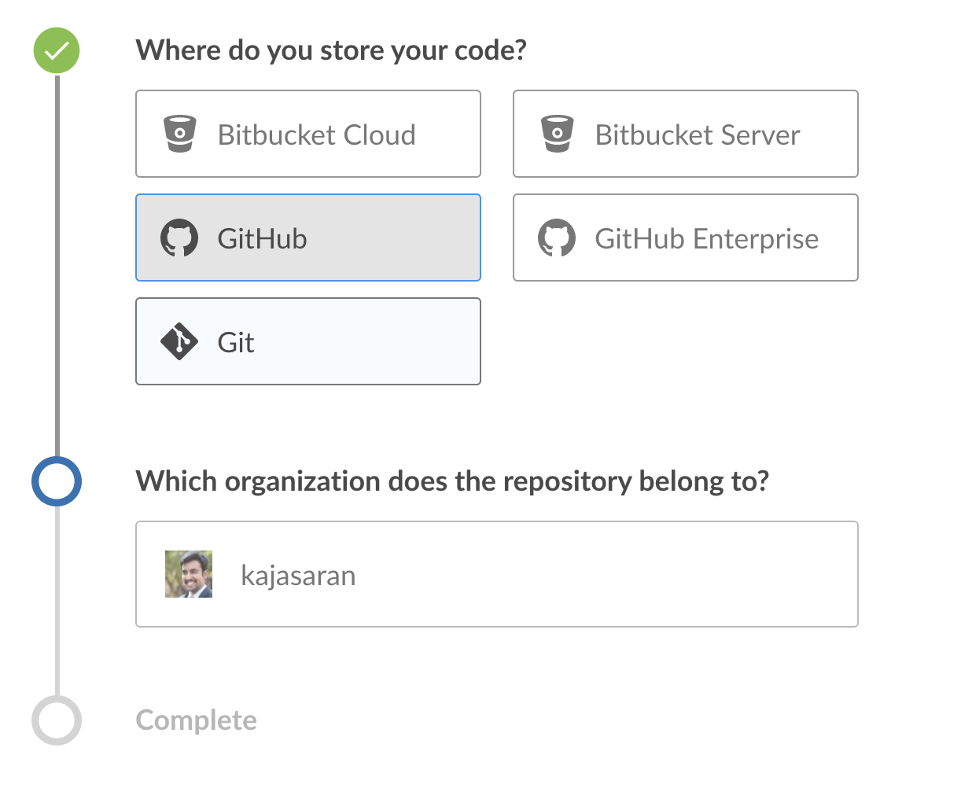
steps to build a pipeline
Run docker
Run Jenkins container on docker with blue ocean image
Configure Jenkins
Open blue ocean-> New pipeline

Slide 8
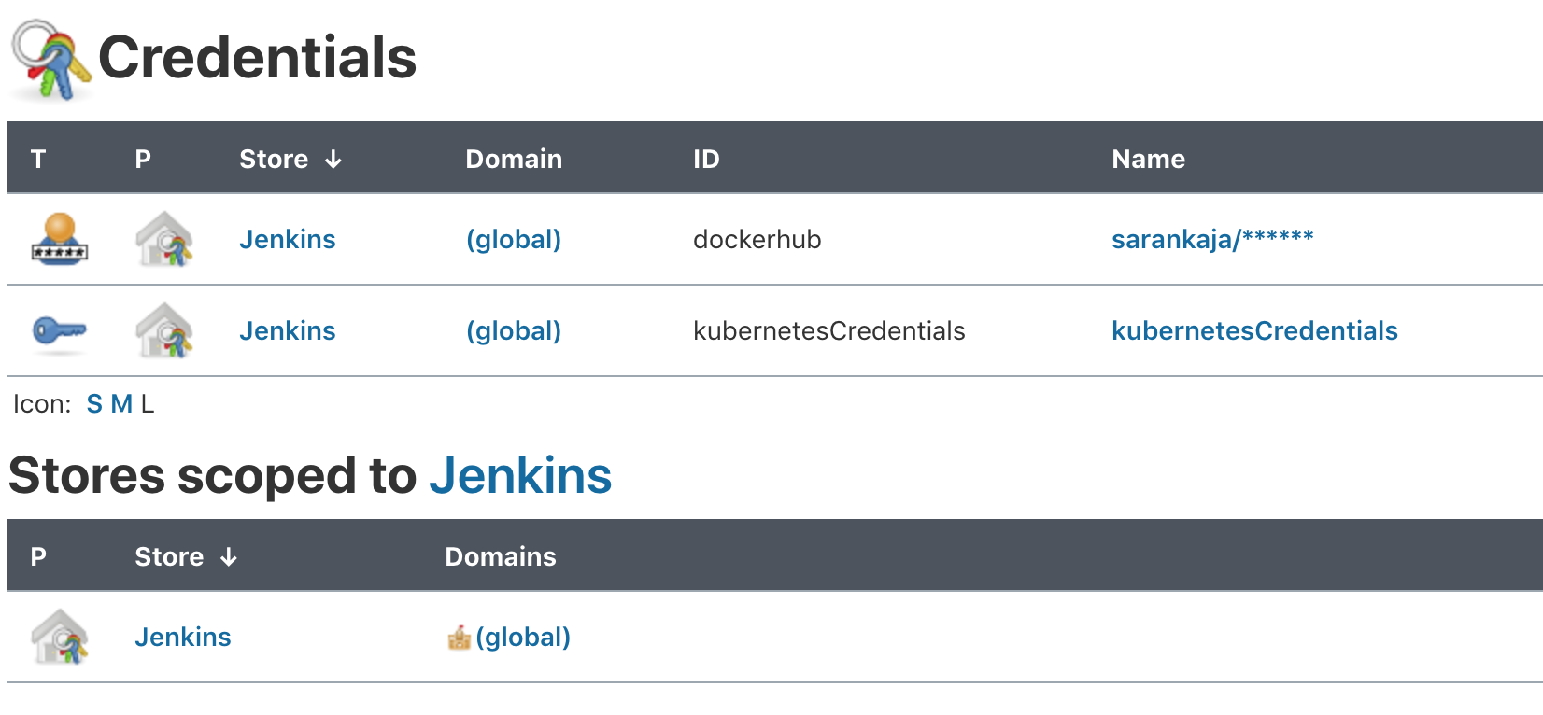
Contd.
4. The above step will create a webhook with your git using your Jenkins file
5. create security keys in jenkins

Slide 9
Blue ocean pipeline output
Once all the files are configured properly the pipeline appears as follows

Slide 10
Jenkins pipeline output

Slide 11
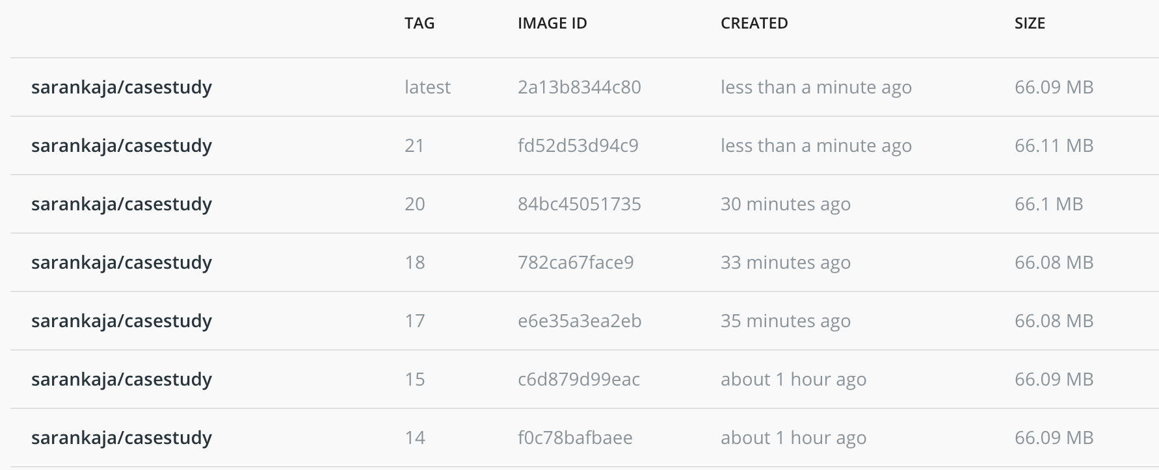
Docker Output
You can see the image been built after each iteration

Slide 12
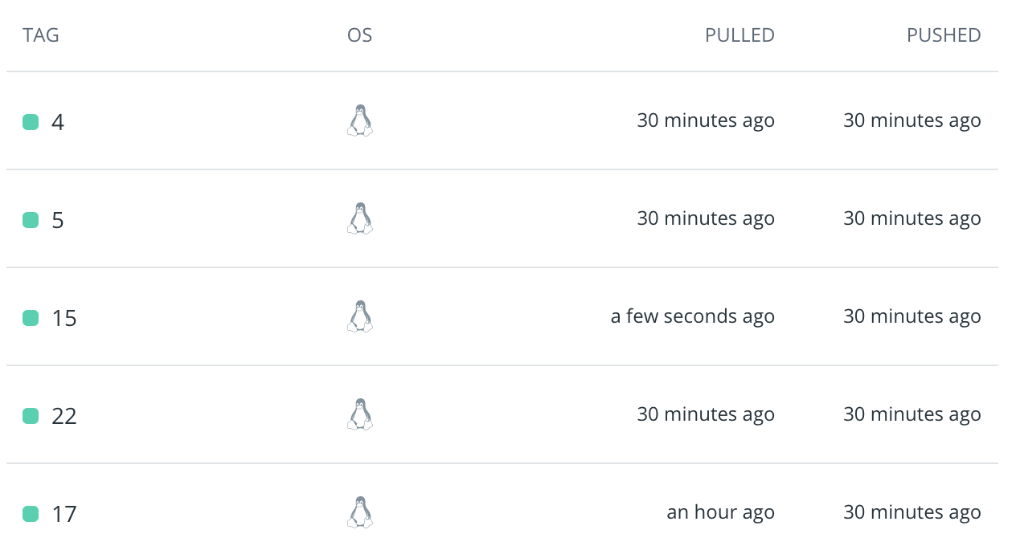
Docker Hub Output

Slide 13
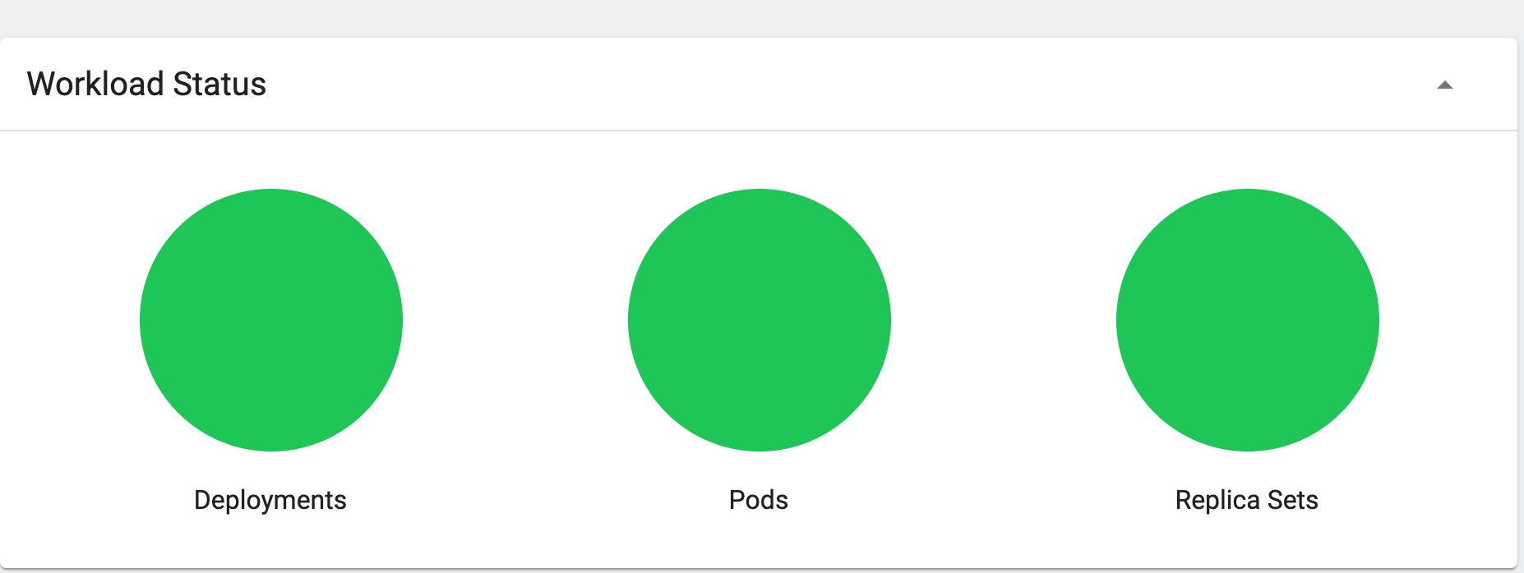
Kubernetes Output
You can see the final output In Kubernetes where all the pods are green

Slide 14
Our desired output

Slide 15
Steps to test at every stage and build
Clone the repository
Test if the flask app is working in all the stages in local
Deploy the flask app in Jenkins
Create the Jenkinsfile to run all the services

Slide 16
Next Steps
Migrating this to Cloud
And adding testing and monitoring tools

